Slide 1

Year 7
Welcome Evening
25th March 2026

Slide 2

Mr Crowther
Principal

Slide 3
Empowering Ambition, Embracing All

Slide 4

BE
KIND
WORK
HARD

Slide 5

Our 3R’s
Respect
Treat others with kindness
Responsibility
Be accountable for your actions, words and learning
Resilience
Develop the ability to overcome challenges and learn from setbacks

Slide 6

Academic Excellence
Wellbeing and Pastoral care
Enrichment
Transition support
Communication and Parental Partnership

Slide 7

From June, mobile phones will no longer be allowed to be used for teaching and learning in lessons

Slide 8
Length of the school week:
‘We expect all schools to deliver a minimum school week of at least 32.5 hours’
(Government Response to Curriculum and Assessment Review – November 2025)
‘During inspections, inspectors will consider the extent to which the school week meets the DfE’s minimum expectation of 32.5 hours per week’
(Ofsted – September 2025)

Slide 9

From September, school will continue to start at 08:40am, with students expected to be in form rooms by that time.
Every day will finish at the standard time of 3:10pm

Slide 10
Mondays, Tuesdays, Thursdays, Fridays
Session | Time | Duration
Registration | 08:40–09:05 | 25 mins
Period 1 | 09:05–10:05 | 60 mins
Period 2 | 10:05–11:05 | 60 mins
Break | 11:05–11:25 | 20 mins
Period 3 | 11:25–12:25 | 60 mins
Lunch | 12:25–13:10 | 45 mins
Period 4 | 13:10–14:10 | 60 mins
Period 5 | 14:10–15:10 | 60 mins

Slide 11
Wednesdays
Session | Time | Duration
Registration & PSHE | 08:40–09:30 | 50 mins
Period 1 | 09:30–10:30 | 60 mins
Period 2 | 10:30–11:30 | 60 mins
Break | 11:30–11:45 | 15 mins
Period 3 | 11:45–12:45 | 60 mins
Lunch | 12:45–13:20 | 35 mins
Period 4 | 13:20–14:20 | 60 mins
Enrichment | 14:20–15:10 | 50 mins

Slide 12

Uniform

Slide 13
Gaia Moles Yr.9
Student Experience

Slide 14
Mrs Burridge
Transition Lead

Slide 15
What happens between now and our transition days?
We will visit students in their primary school setting to observe them in a familiar environment and begin building positive relationships.
We will interview Year 6 students and their parents online to gather key information and support a smooth transition.
We will collect information from Year 6 teachers to ensure we understand each student’s strengths, needs, and prior learning.
We will allocate students to tutor groups and Houses based on the information collected.

Slide 16
Key Dates
Transition Days
29th June – SEND students only
30th June – Vulnerable students (as agreed with Head of Transition and SENDCo)
1st & 2nd July – All Year 6 students
Primary School Visits (Transition Lead/HOY/PM)
From 15th May onwards
Online Interviews with Students and Parents
Week commencing 18th May
New Intake Evening
Thursday 2nd July
Summer School
Monday 27th –29th July
First Day
Wednesday 2nd September Y7 & 12 only
High adventure Y7 Team building Trip
Monday 5th – Friday 9 October

Slide 17


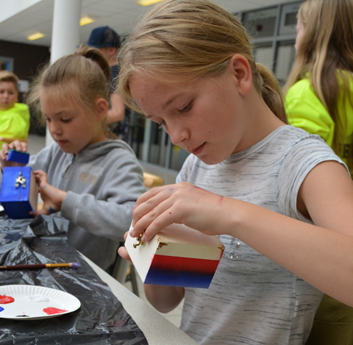
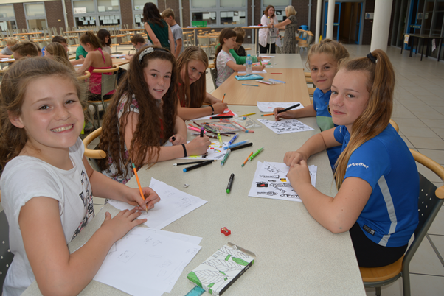

Summer School 2026
27th-29thJuly
Letters of invitation will go out to all parents after Easter.
Places are from free to £10 PD.

Slide 18
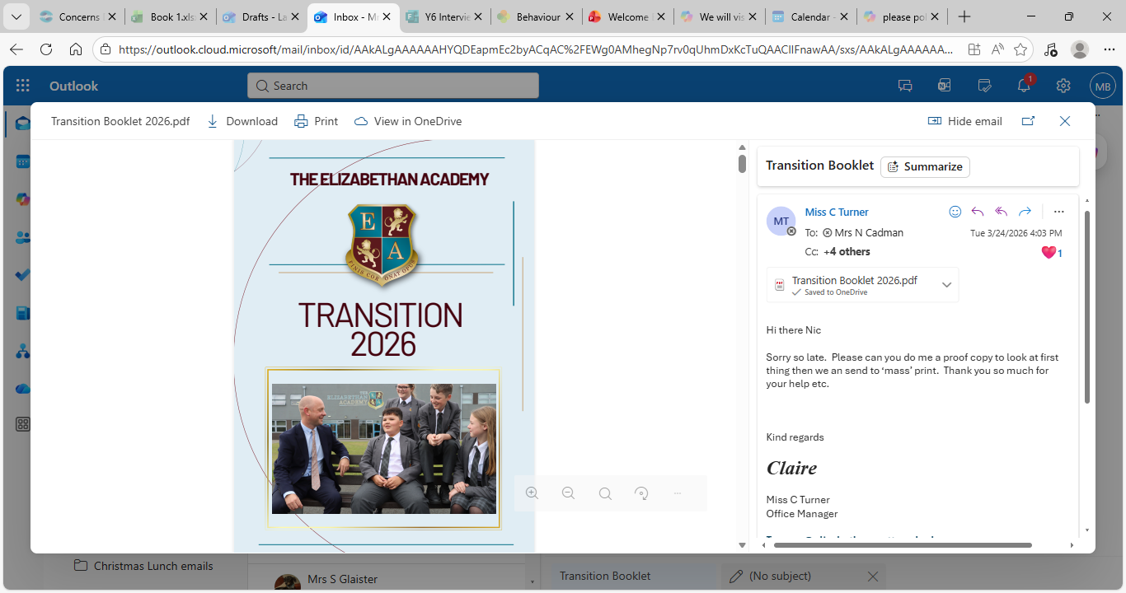
Getting prepared for The Elizabethan Academy
www.elizabethan.notts.sch.uk
Transition Tab

Slide 19
Mr Thunder- Head of Year 7
Mrs Mason – Pastoral Manager Year 7

Slide 20
The Year Team
Team of 8 experienced tutors from a range of subject disciplines
Structured tutor programme including assembly, celebrations, notices, PSHCE and competitions
Form tutors are contactable by email and are the first port of call when communicating with school about day-to-day issues (i.e. uniform, homework, minor pastoral issues)

Slide 21
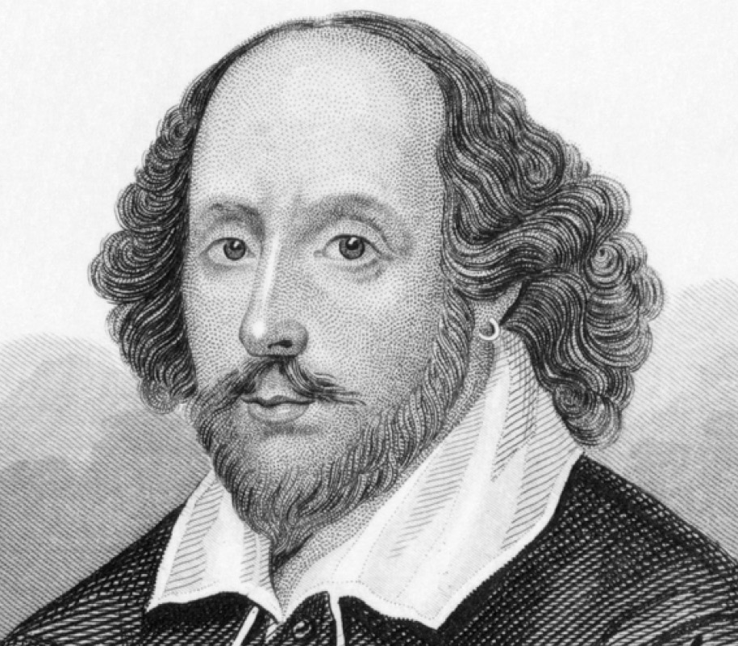

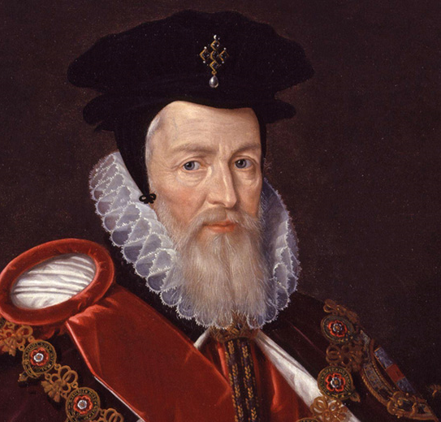

Academy Houses
Shakespeare
Hardwick
Burghley
Galileo

Slide 22
Mrs A Stocks
Senior Assistant Principal

Slide 23
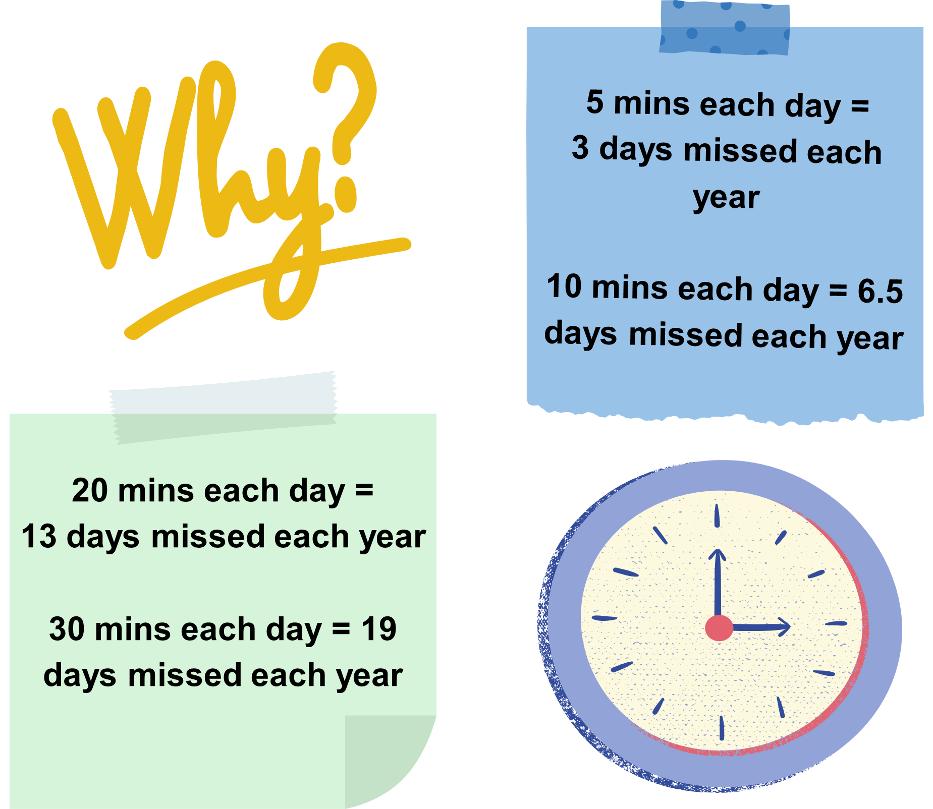
‘Beat the Bell!’

Slide 24
‘Beat the Bell!’
What is expected?
  The first bell goes at 8.35. Aim to get to school by 8.30am at the latest to allow yourself a few minutes to get organized for your day.
  The second bell goes at 8.40 am. You must be at your form room by the time this bell goes. Punctuality will be rewarded! ☺
  If you arrive at your form room after 8.40 am without a valid ‘late bus’ slip, you will be marked as late and receive a 10 minute late detention.

Slide 25
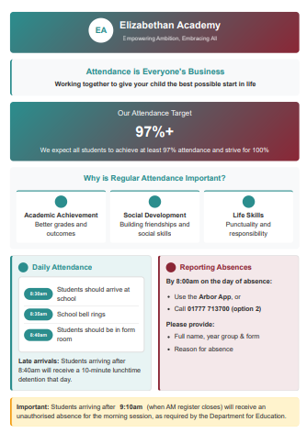
Daily Attendance Procedures
Med
What is expected?
All students to achieve 97% + attendance (and to strive for 100%!)
Illness to be communicated by 8am on the Arbour App (preference) or by calling 10777 713700
Medical appointments to be made outside of school time wherever possible.
Term time leave will not be authorised, unless in exceptional circumstances

Slide 26
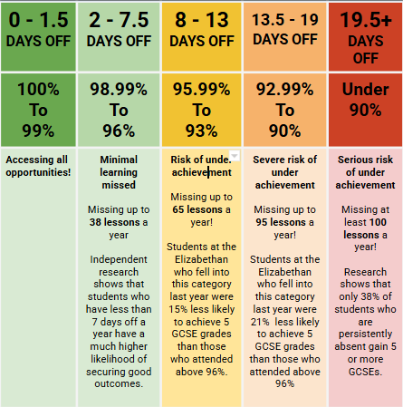

Slide 27
Miss Clark
Vice Principal

Slide 28
Year 7 High Adventure trip week
Monday 5 – Friday 9 October
All Year 7 will be off normal timetable ​to cement their transition through a range of activities and workshops that will use and develop key skills and qualities to help them become … ​
organised and independent learners​
active and keen participants in life ​
confident in leading and interacting with others ​
more knowledgeable and aware around safeguarding, personal safety and wellbeing​

Slide 29
Year 7 High Adventure trip week
Monday 5 – Friday 9 October
The trip will be organised as follows …
Group 1 … will depart Monday to arrive at 12:00, leave Wednesday at 13:00
Group 2 … will depart Wednesday to arrive at 12:00, leave Friday at 13:00
The activities students can access at High Adventure will be a combination from team building challenges, climbing, canoeing, rafting building, stream scrambling, caving, high ropes, low ropes, zip-line, abseiling and more
The cost of the trip is £260

Slide 30
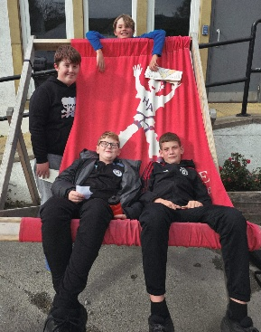
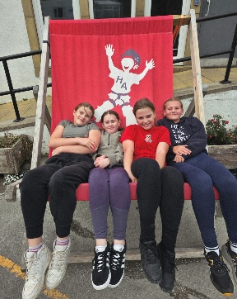
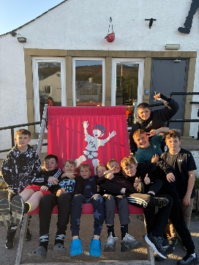
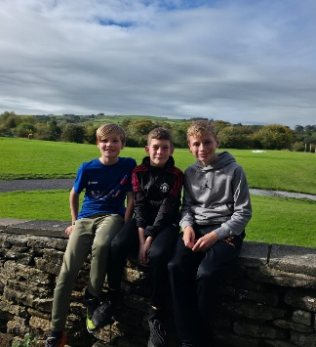
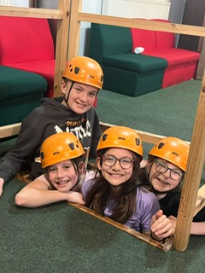
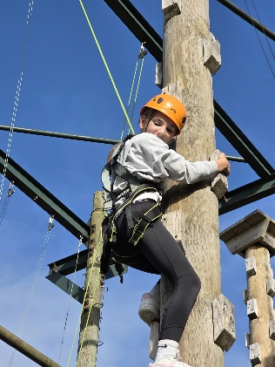
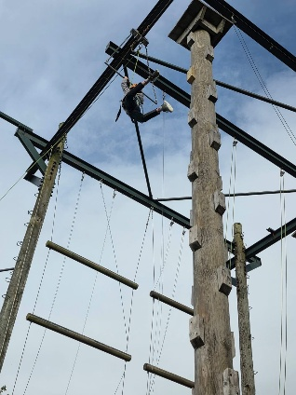
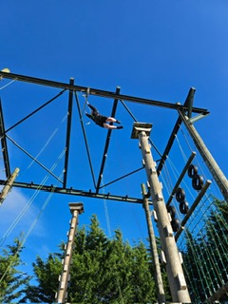
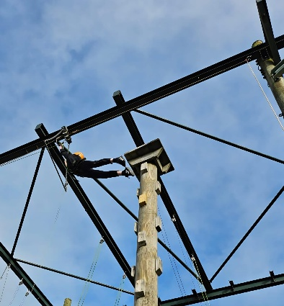
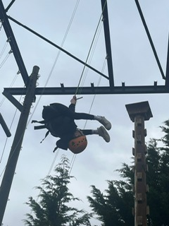
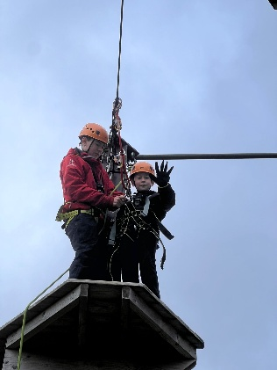
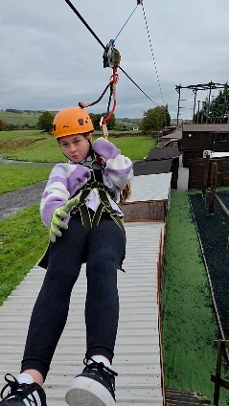
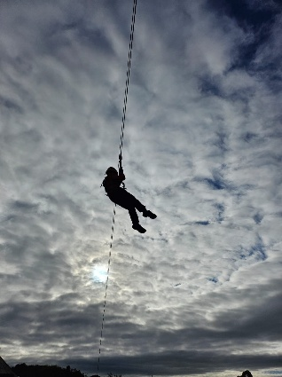
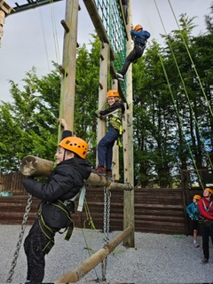
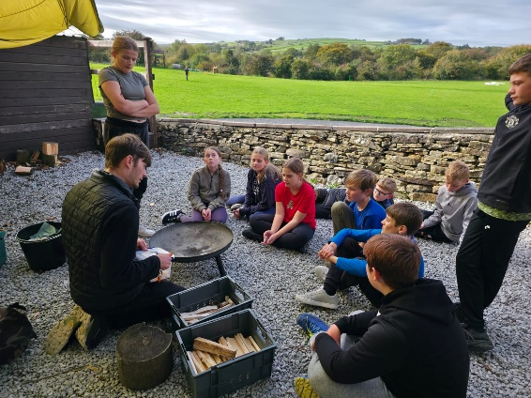

Slide 31
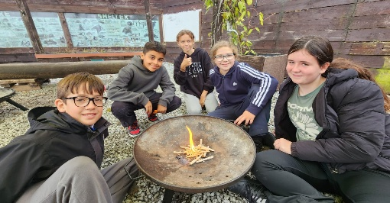
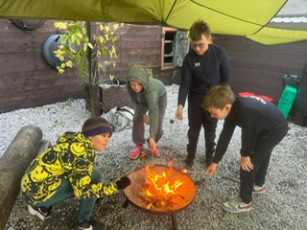
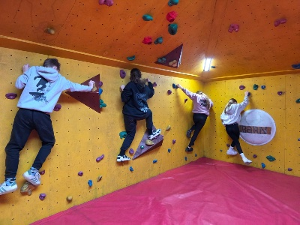
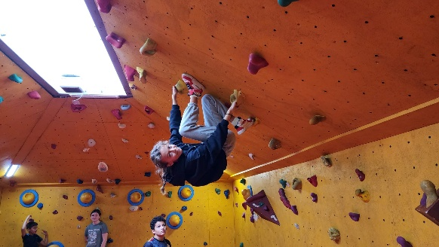
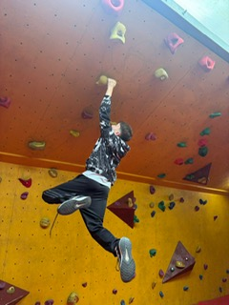
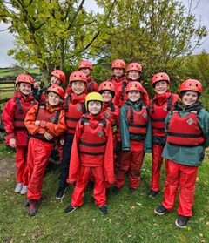
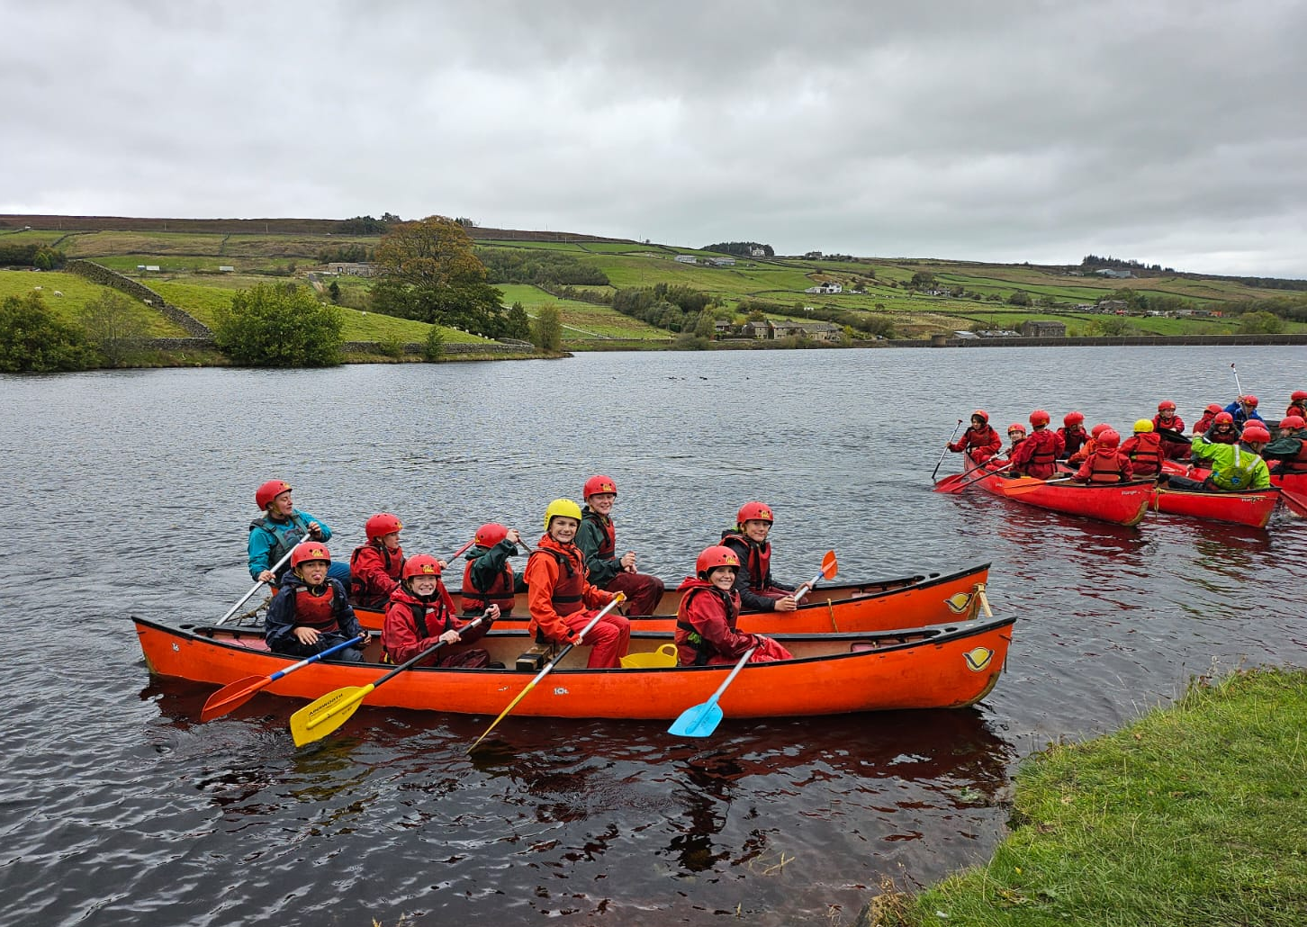
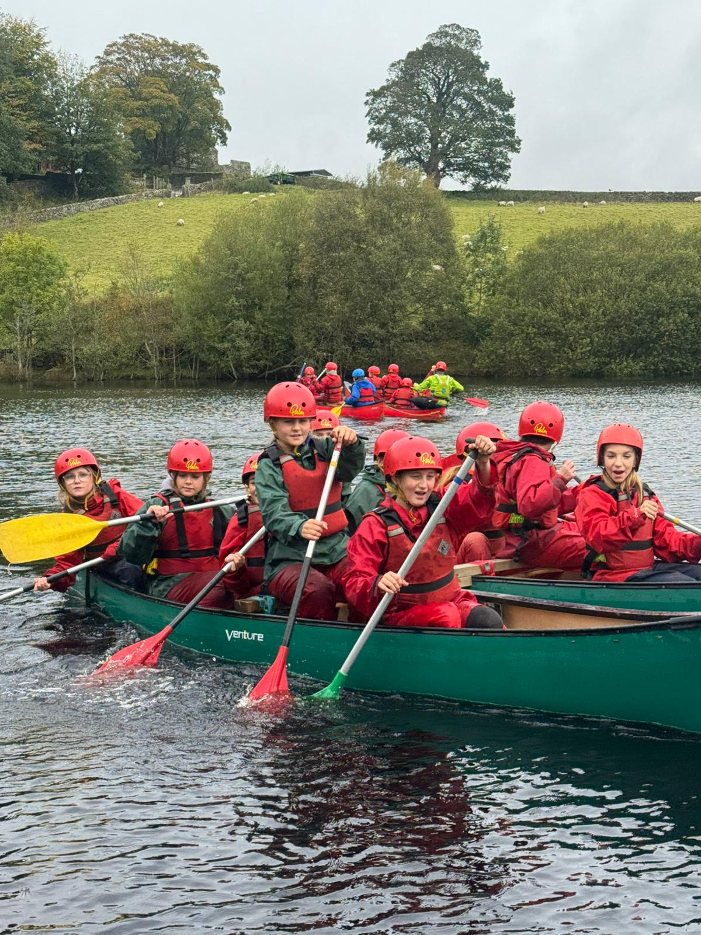
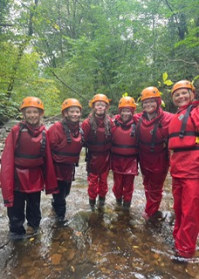
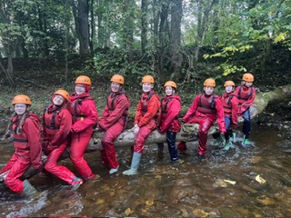
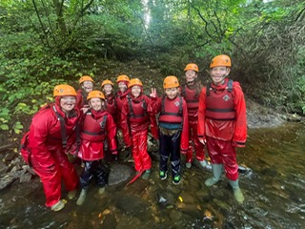
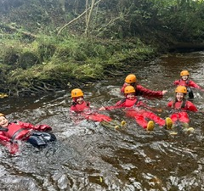
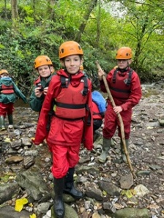
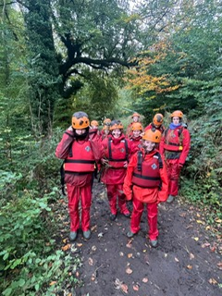
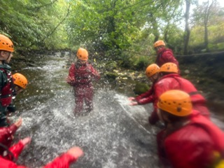
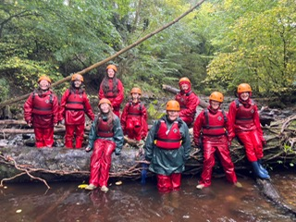
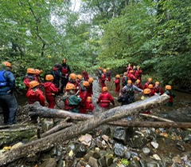
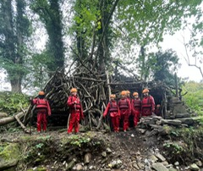

Slide 32
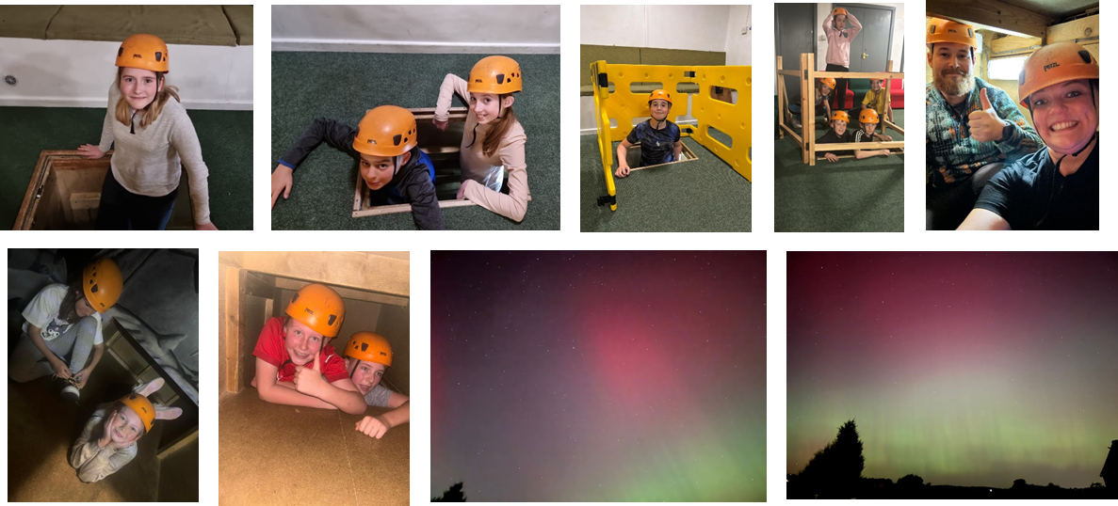

Year 7 High Adventure trip week
Monday 5 – Friday 9 October
Secure a place for your child
Non-refundable deposit of £100 by Friday 22 May
Payment via iPay … pay towards balance from now
Further details at the New Intake Evening on 2 July

