Slide 1
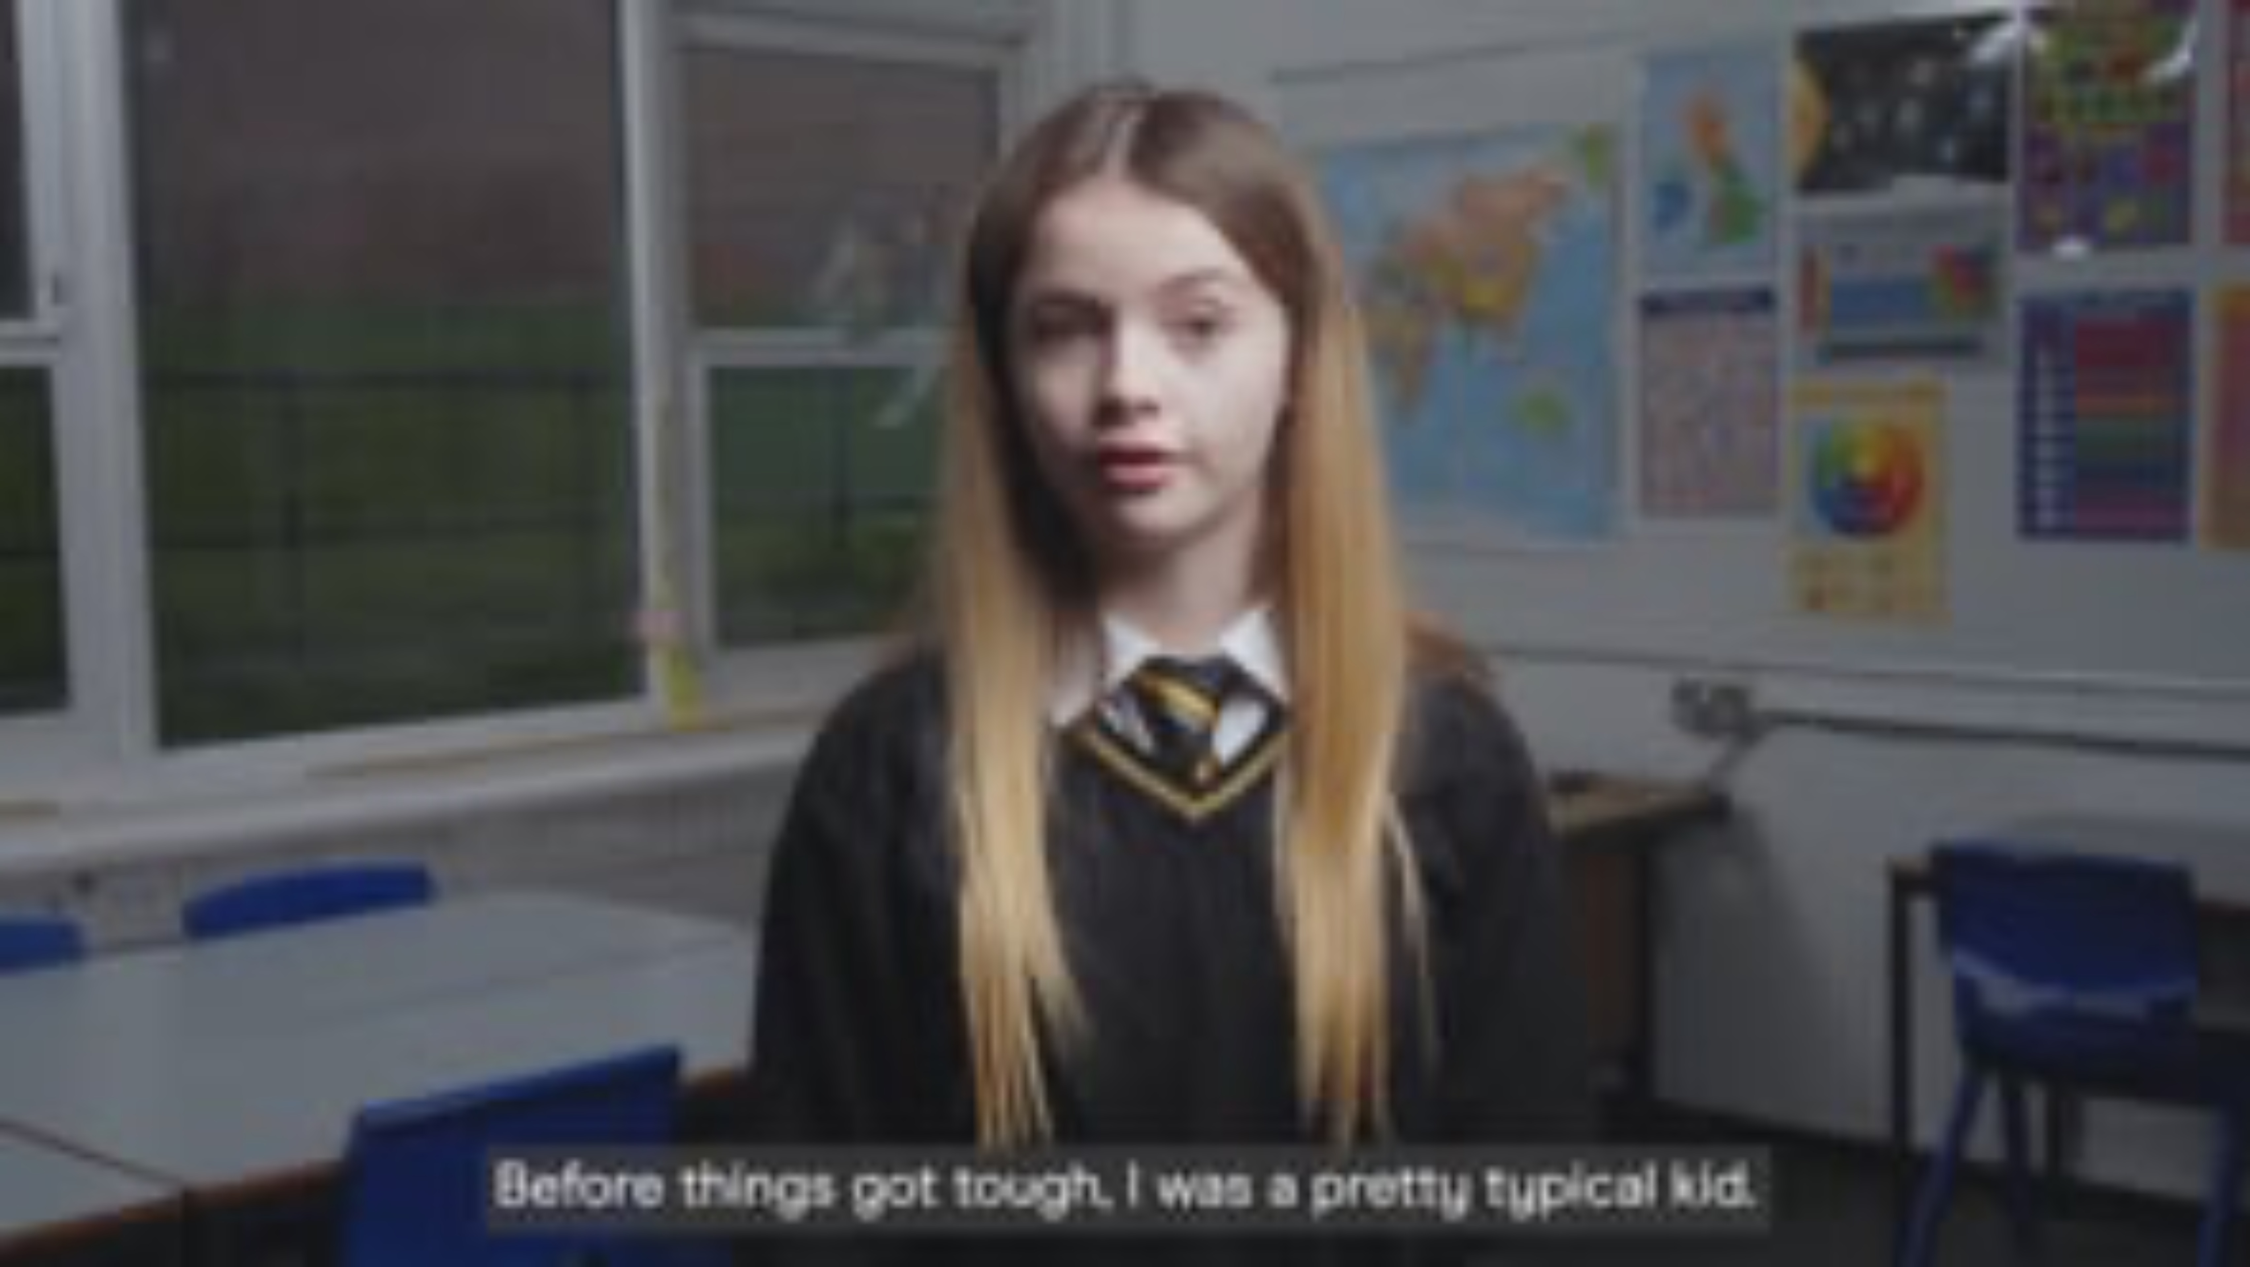
Why Pupil mental health matters

Slide 2

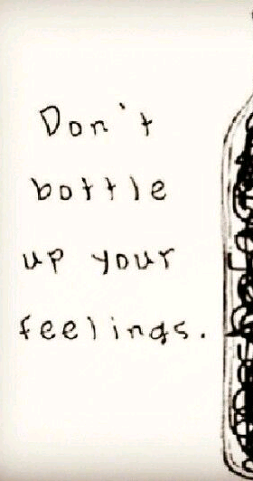
Mental Health Stigma
People are more aware of mental health concerns than ever before.
Make sure you talk to someone if you need help. And, if someone talks to you, make sure you listen.

Slide 3


Everyone has mental health, just like everyone has physical health.
It's not a sign of weakness to ask for help with yours - in fact, it's a sign of strength.
Don't suffer in silence.

Slide 4




You can speak to any member of staff in school, your parents, family or your friends

Slide 5

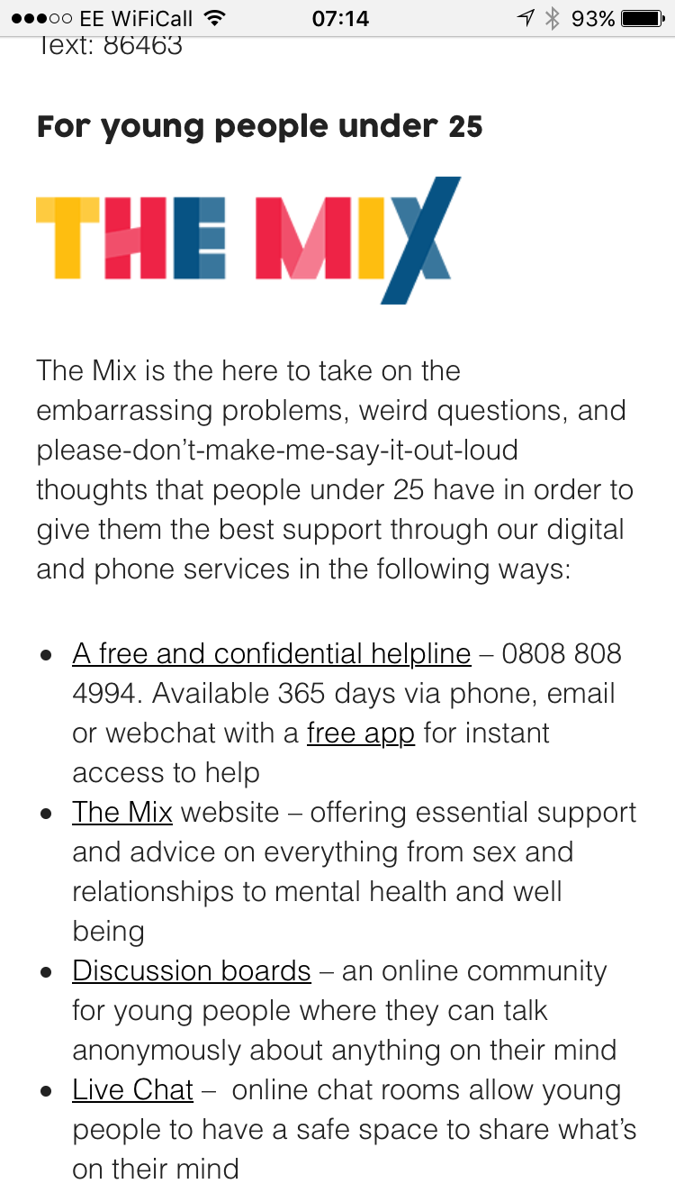

Slide 6
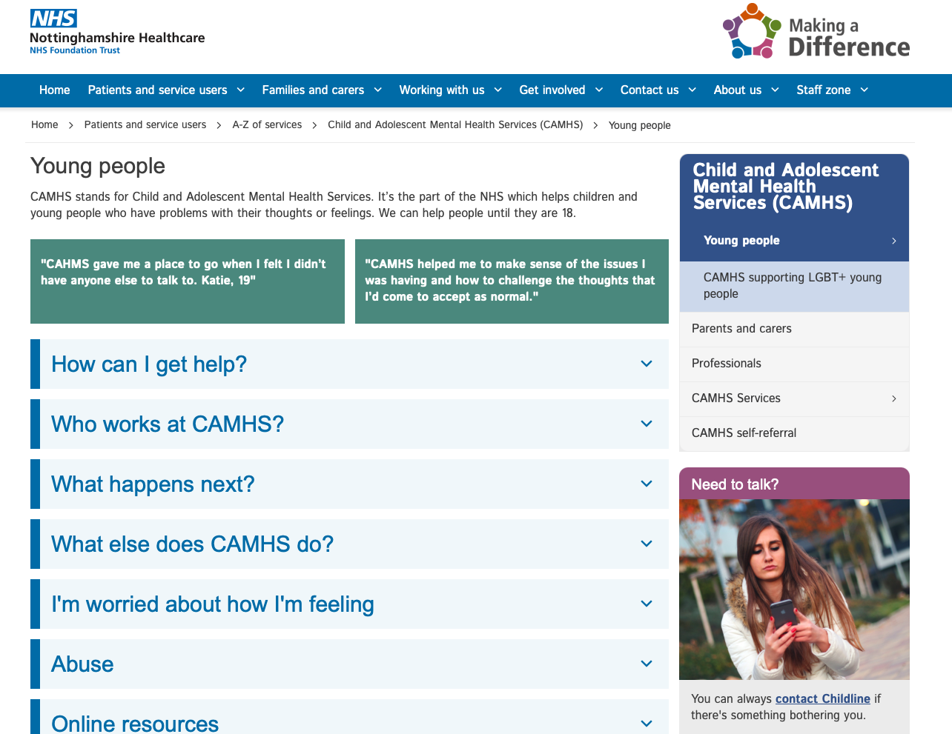
Notts CAMHS website
Self-refer to the MHST

Slide 7
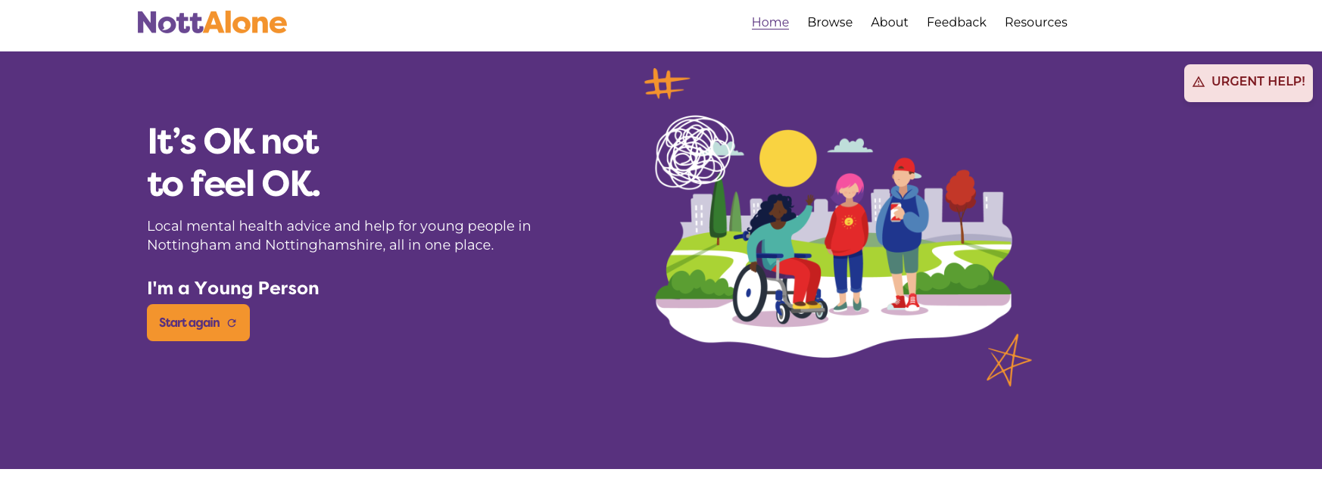
Nott Alone – you can view for yourself or if you are worried about someone else

Slide 8


Slide 9
Safeguarding means …
Providing help and support to meet the needs of children as soon as problems emerge
Protecting children from maltreatment within or outside the home, including online
Preventing impairment
of children’s mental
and physical health
or development
Making sure children receive safe and effective care
Taking action to enable all children to have the best outcomes
Notes:
Explain that to effectively safeguard children, we need to know what we mean by the term ‘safeguarding’
Essentially, safeguarding means protecting children from harm, so they can grow up safe, happy and healthy
Remind staff that children are children until they are 18
Select to bring up each element in turn. In more detail, safeguarding means:
Providing help and supporting to meet the needs of children as soon as problems emerge
Protecting children from maltreatment, whether that is within or outside the home, including online
Preventing impairment of children’s mental and physical health or development
Making sure children receive safe and effective care as they grow up
Taking action to enable all children to have the best outcomes
Tell staff that the definition of safeguarding on the slide is set out in Keeping Children Safe in Education (KCSIE) and that you’ll look at changes to the guidance in later slides
Sources:
GOV.UK – Department for Education (DfE), Keeping Children Safe in Education. https://www.gov.uk/government/publications/keeping-children-safe-in-education--2

Slide 10
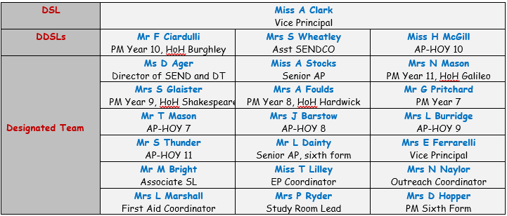
Here to listen: our safeguarding team
Notes:
[In advance, edit this slide to include details of your school’s safeguarding team, as set out on the slide. If anyone works part-time, you might want to include what days they work as well]
Explain that if staff have concerns (examples of which will be discussed in this session), they need to report it to your school’s safeguarding team
Your safeguarding team has particular responsibilities for safeguarding, beyond the responsibilities that all staff have
Explain that the people on the slide make up your school’s safeguarding team
Briefly talk through each person and their responsibilities
Remind staff that the safeguarding team can support staff as well as pupils

Slide 11
Examples of safeguarding concerns
4 main types of abuse – physical, emotional, sexual, neglect
Missing school, persistent absence, truancy
Child-on-child abuse
Online grooming
Online misinformation and fake news
Toxic masculinity
Sextortion
Child criminal exploitation eg county lines
Domestic abuse

Slide 12
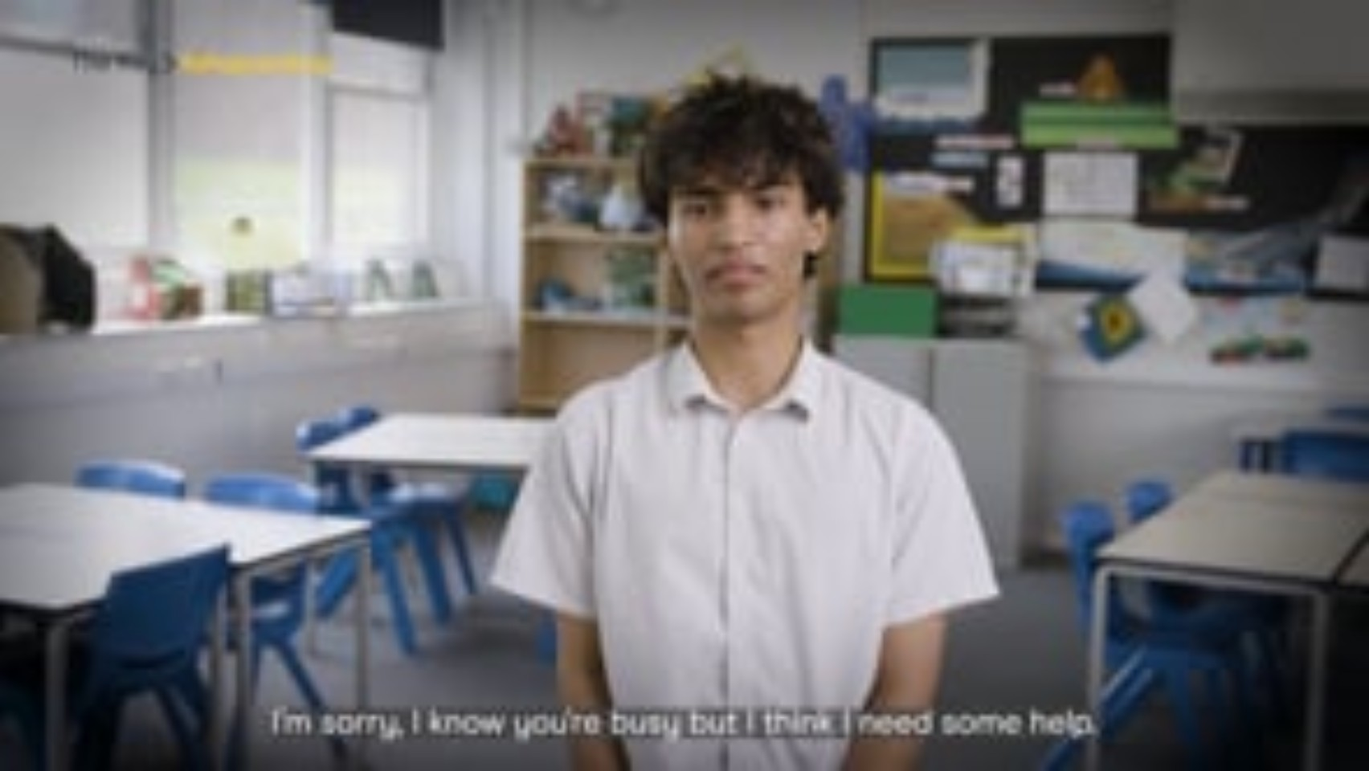
Listen to Ben’s experience
Video
Trigger warning: This video contains reference to physical abuse and domestic violence, which some students might find upsetting
Notes:
[Select play to start the video: 2:07]
Remind staff that children might not know how to, or be ready to report or even speak about abuse
Children might not tell someone about abuse because they:
Don’t recognise their experiences as harmful
Are ashamed or embarrassed
Have been threatened (or a family member has been threatened)
Are being blackmailed
Are worried about not being believed or about what might happen next
Feel they don’t have anyone to turn to
Are worried that they might get a family member in trouble
Disabilities, sexual orientation, vulnerabilities and language barriers might also affect children’s ability or willingness to talk about abuse
It’s important staff can respond appropriately if a child does tell them about abuse, so we’re going to spend some time looking at this now. We’re going to start by watching a video where you see a child tell an adult about a harmful experience they’ve had
Note afterwards that the video has been voiced by an actor, but the story is real
Video source: https://vimeo.com/1097853771/8c57a7de98?share=copy
Sources:
GOV.UK – DfE, Keeping Children Safe in Education. https://www.gov.uk/government/publications/keeping-children-safe-in-education--2

Slide 13
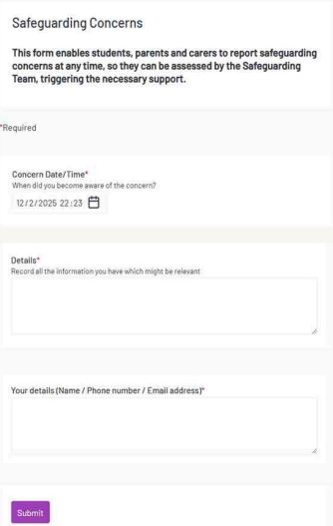
Tell us … please don’t suffer in silence or let others suffer
https://form.thesafeguardingcompany.com/f290d817-1fbc-4026-961b-73878652c317
The information will be shared with our safeguarding team who will intervene and support.

Slide 14
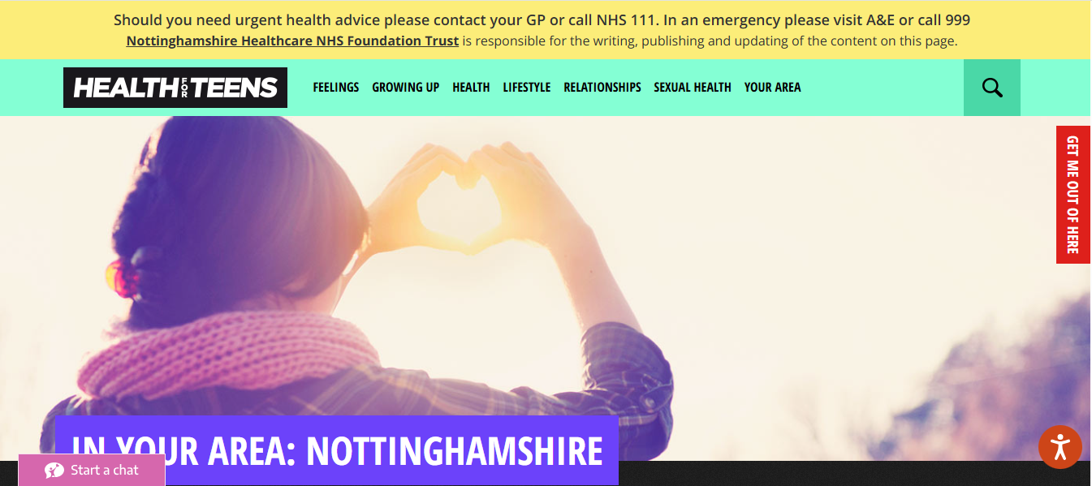
https://www.healthforteens.co.uk/nottinghamshire/

